Slide 1

Orange Business Corporate Presentation
May 2026

Slide 2
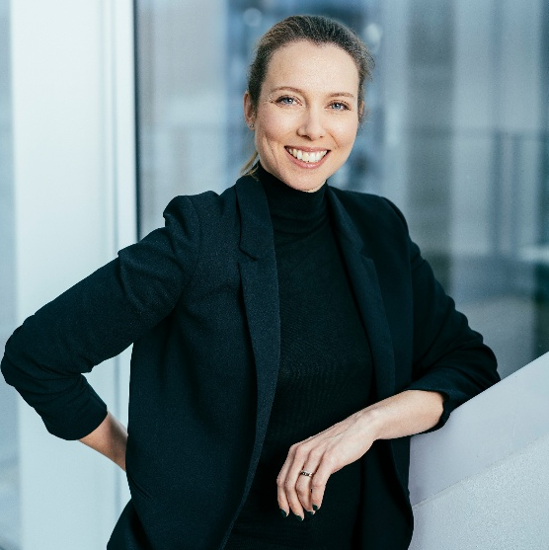
“We make the complex clear, bringing trust to a crazy world. Our end-to-end services, from networks to digital solutions, ensure our clients can move forward with confidence.”
Aliette Mousnier-Lompré CEO Orange Business

Slide 3
Contents
Who we are Orange Business: at once an operator, integrator and platform player
What sets us apart An end-to-end player across the digital value chain
How we do it The right expertise, at every step

Slide 4

Who we are Orange Business: at once an operator, integrator and platform player

Slide 5



The world is transforming. So are our challenges.
The all-digital expectation
Mastering the cloud
Our customers and employees expect smooth, instantaneous, and hyper‑connected experiences.
Migrating, managing, and securing a multi‑cloud environment has become a major challenge, balancing performance, costs, and sovereignty.
The trust imperative
The sustainability challenge
In an uncertain world, cybersecurity, data protection, and ethics are at the heart of the trust our stakeholders place in us.
Our customers, partners, and society expect concrete and measurable environmental commitments from us.

Slide 6


Our vision Possibility starts with tech you trust
The possibilities for innovation and growth are limitless, but so are the challenges. Great ideas can reshape industries, solve urgent problems, and make lasting impact. Yet navigating complex networks, regulatory hurdles, and security risks can feel overwhelming. Without the right foundations, even the most ambitious visions risk remaining just ideas.​
That’s why Orange Business exists: to turn “what if” into “what is.”
Possibility starts with tech you trust
From our beginnings as a French public service company, Orange Business is now a global operator, integrator, and platform player.
Through strategic acquisitions along the way, Orange Business has diversified into delivering dependable, end-to-end services, from networks to digital solutions, that ensure our customers and partners can move forward with confidence. And in this highly competitive and dynamic industry, we empower our employees with the tools, resources and opportunities needed to continue to excel.
Discover our vision film

Slide 7

Our ambition Becoming a leader in trusted digital services
Our industry is changing fast. Legacy telecom revenues are declining, competition is intensifying, and customers’ expectations are evolving.
Yet these challenges open a new chapter for Orange Business to shape our path to trusted digital leadership.

Slide 8

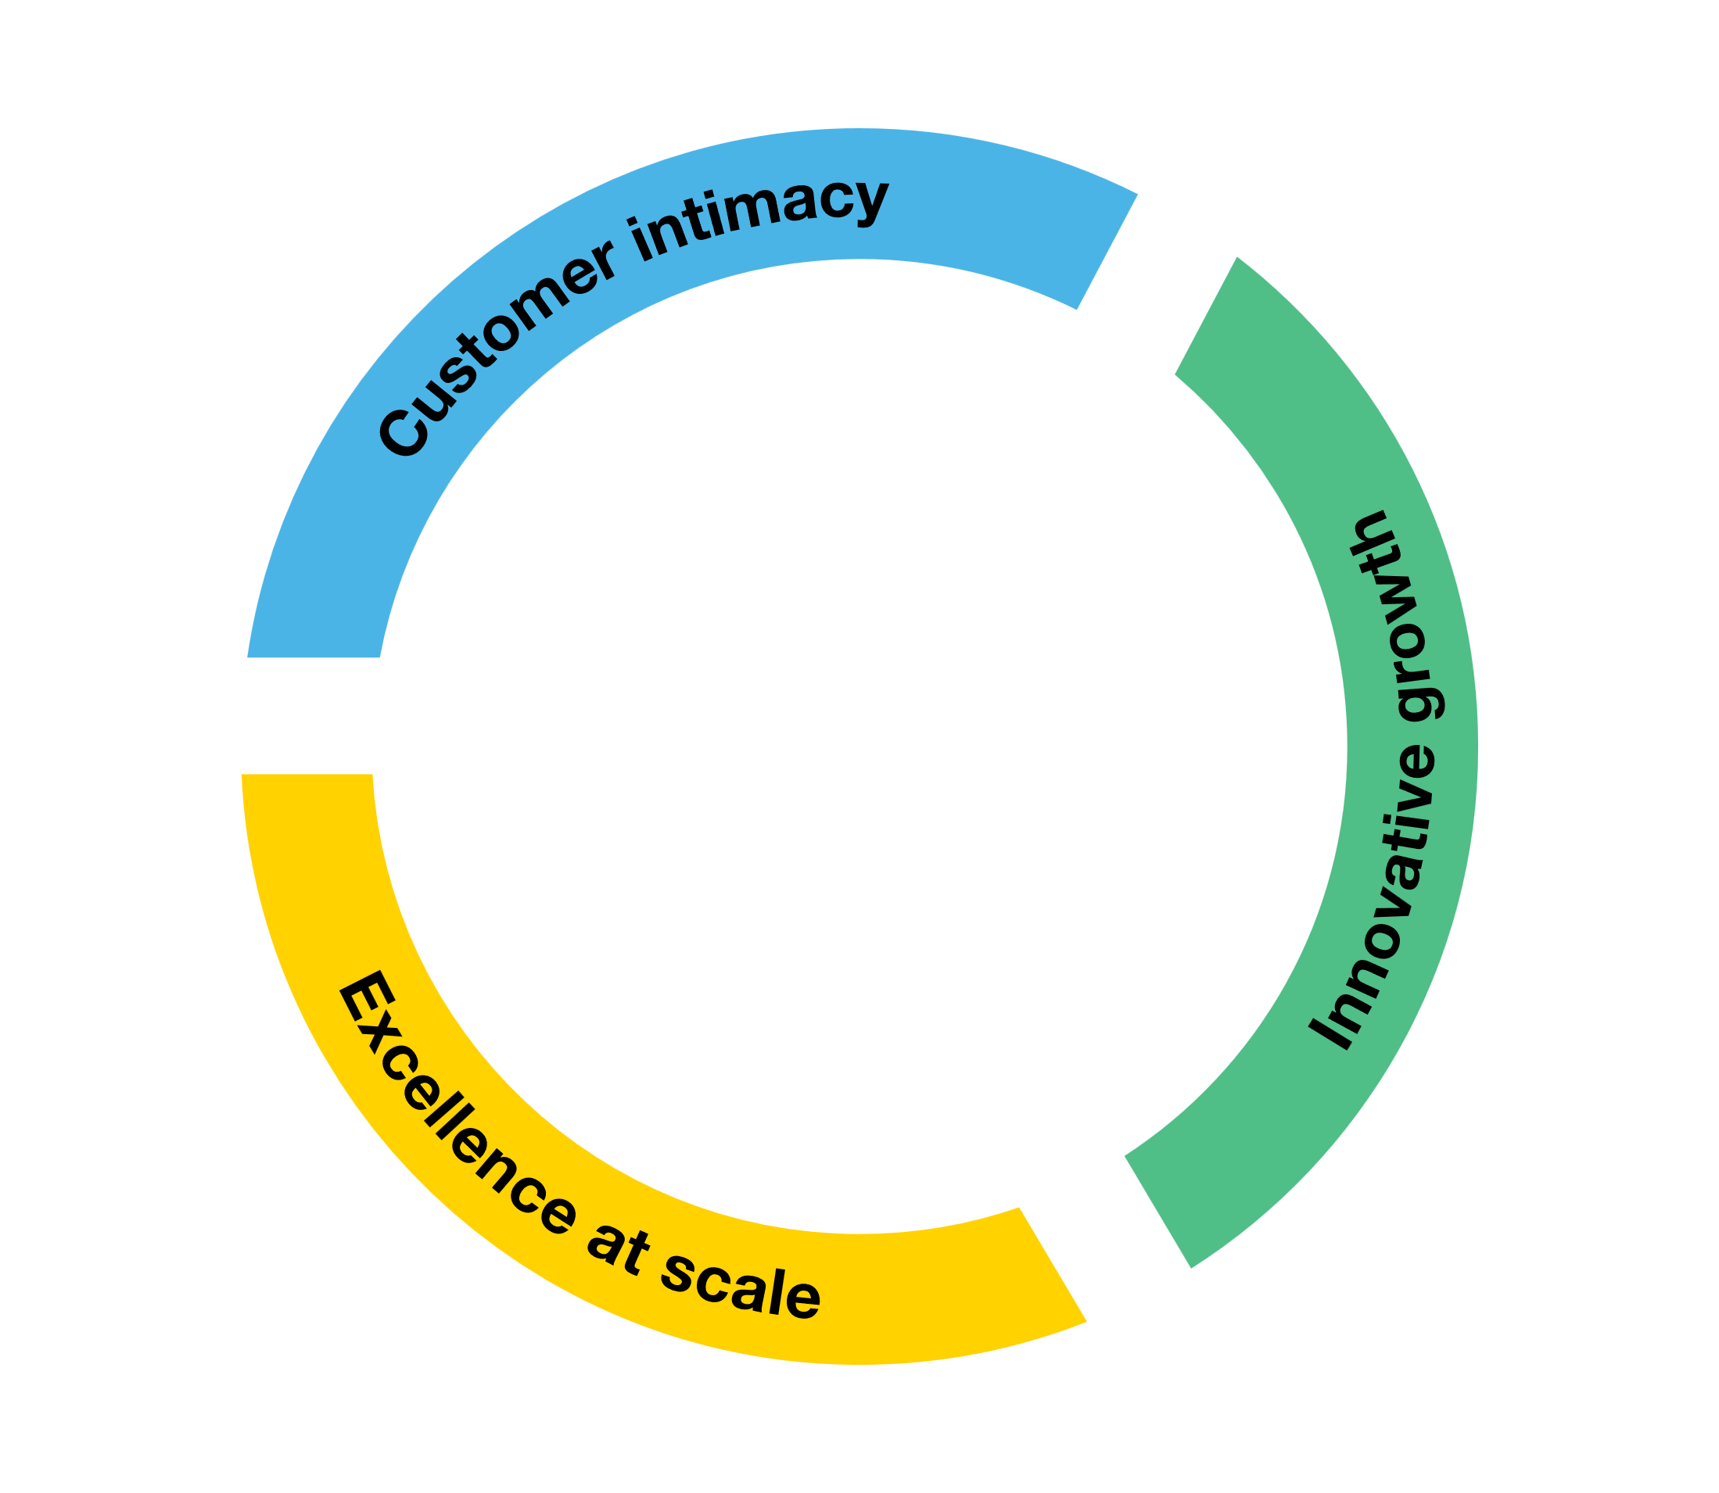


Our strategy
With Trust the future, our new strategic plan, Orange Business is accelerating its transformation to become a leader in trusted digital services; strengthening customer relationships, scaling secure connectivity, cloud and AI, and enhancing competitiveness.
Maximize the value of our core business by leading on secure connectivity
Enhance our scale and our competitiveness
Unlock growth opportunities by scaling trusted cloud and AI
Committed to our clients, our people, society and the environment

Slide 9





The Orange Group
Orange Group numbers
In a world where digital technology is omnipresent, trust in a telecom operator is crucial. Orange's purpose defines its role as a trusted operator: guiding its commitment to protect against cyber threats, secure networks and personal data, and support as many people as possible in their daily use of technology, with ethics and responsibility.
Orange Business is the enterprise division of the Orange Group.
As a global operator, integrator, and platform player, it helps companies navigate digital transformation with reliable, secure, and sustainable technology.
26 countries
In B2C
340+ million
customers
€40,4 billion
revenue in 2025
1st
Mobile network in France
Watch our history film
123,500
Employees worldwide

Slide 10






Orange Business at a glance
Orange Business brings together the scale of a global operator, the expertise of a systems integrator, and the agility of a service platform player to seamlessly unify networks, cloud, data, AI, and security.
€7,3 billion
Revenue in 2025
30,000
Employees
+6,8% Cyberdefense*
Revenue growth in 2025
40,000+
B2B customers worldwide
200+ countries
covered by Orange Business, supervised 24/7
70+ Data Centers across 5 continents
for global hosting and cloud solutions, including sovereign infrastructure for customers requiring the highest level of data protection (Cloud Avenue, Ready SecNumCloud)
*Orange Business, powered by Orange Cyberdefense

Slide 11
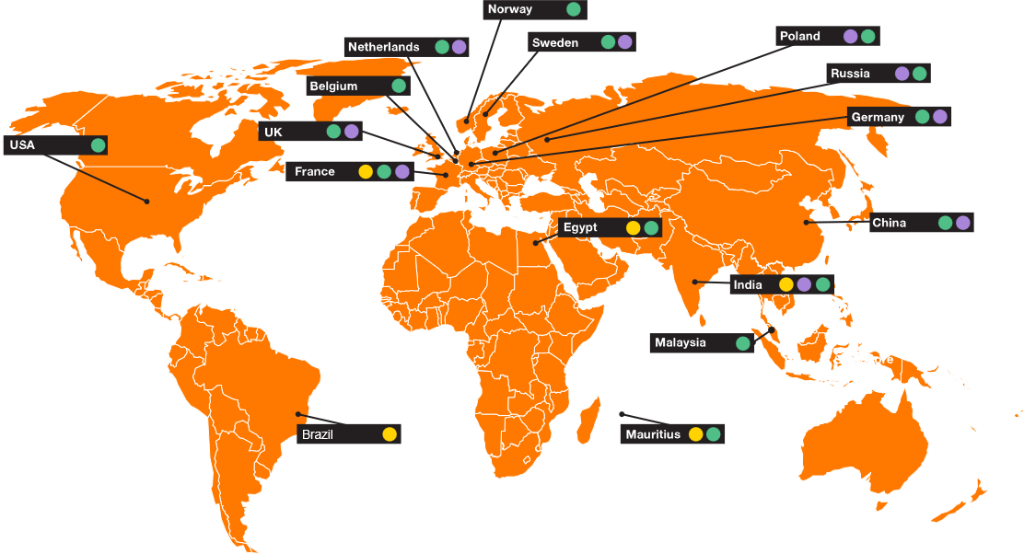
Global presence, local service
With our strongest footprint in Europe and teams located in 65 countries worldwide, Orange Business combines deep local expertise with true global reach, deploying and monitoring networks and digital solutions daily.
18 Security Operational Centers (SoC) around the world, monitoring and responding to events 24/7/365
15 CyberSoc that bring together the best expertise in threat analysis
6 Major Service Centers (MSCs) located on all continents for 24/7 support

Slide 12












Meeting the major digital challenges faced by enterprises, together
All over the world, Orange Business works with businesses across a wide range of industries to make their digital transformation impactful and sustainable. Orange Business is trusted for its expertise in connectivity, cloud and cybersecurity.
Since 2025 we have introduced a particular focus on sectors where trust matters most: Defense and Healthcare.

Slide 13
A dedicated Defense & Security Division
Addressing the strategic needs of public and private organizations to protect national interests, citizen safety and territorial defense
An industrialized approach delivering tailored, interoperable solutions designed around 4 pillars
Defense & Security Division
+250 Defense & Security experts
+100 cybersecurity experts specialized in Defense & Security clients
+60 researchers dedicated to defense-related research programs
1
2
3
4
Secure and resilient connectivity
Data Sovereignty
Tactical networks & Operational solutions
Sector-adapted cybersecurity

Slide 14






A dedicated Health Division with an end-to-end orchestration
Orange Business stands at the intersection of digital infrastructure and clinical expertise, combining its full stack of general services with the depth of two healthcare-native subsidiaries, Enovacom and Enovalife, under a single accountable partner.
3,000+
3 Cornerstone activities
3 Differentiating strengths
Healthcare customers rely on Orange Business for connectivity, voice, mobile, cyber, cloud, and data services, alongside our specialized health offerings
1,000+ Healthcare experts
Two health-native subsidiaries, Enovacom and Enovalife
Healthcare providers HIS interoperability, medical imaging, patient journey, cybersecurity
Health Data value creation
Primary and secondary use, AI enablement
A live innovation engine
Direct access to Future4Care’s digital health startups for early-stage co-development
7.2%
Revenue growth projected for 2030
Pharma & Life Sciences
Clinical trials, R&D acceleration, manufacturing
A sovereign full stack
From network to clinical data, SecNumCloud and HDS compliant

Slide 15

What sets us apart An end-to-end player across the digital value chain

Slide 16


Our unique differentiators
Few can see the full picture. As an operator, integrator, and platform player, we understand the entire digital value chain and deliver end-to-end solutions built around what businesses actually need.
Our operator roots, networks and platforms We build and run complex infrastructures at global scale, with a depth of expertise few can match.
Our unique blend of skills and partners We orchestrate the full digital value chain, from connectivity to cloud to cybersecurity (with the right people and the right partners).
Our people are what make the difference They build lasting relationships with customers and help them navigate whatever comes next.

Slide 17









Our strategic value propositions
Our four strategic value propositions deliver exceptional digital experiences for customers, employees and operations.
They are built on secure digital infrastructure, connectivity, cloud, data & AI and cybersecurity, and drive financial, social and environmental performance.
Orchestrate customer interactions
Customer Experience
Collab Hub* – Employee Success Suite
Smart Connected Products
Frontline workers*
Data-AI
Employee Experience
Sustainability
Operational Experience
Digital Building*
Trust
Smart Manufacturing and operation
Digital Infrastructure
GenAI empowered Workforce
NextGenSecured Connectivity
Secure cloud orchestration
* France only

Slide 18
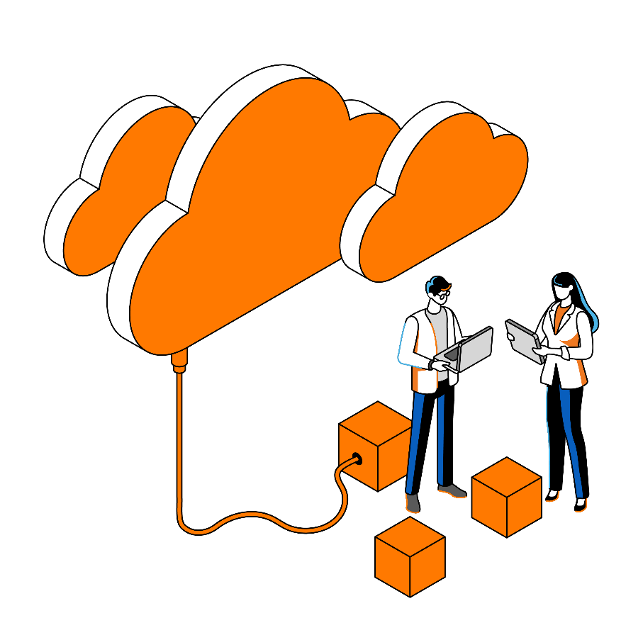
A scalable, reliable and secured digital infrastructure to thrive in the AI era.
Digital Infrastructure Connectivity – Cloud - Cybersecurity
We bring together Cloud, Connectivity, and Cybersecurity with strong integration capabilities.
Our Evolution Platform delivers as-a-service infrastructure and security solutions, built on a collaborative ecosystem of world-leading partners. It's designed to be intuitive, so customers can focus on what matters: growing their business.
Our Cloud Avenue Platform, alongside our partners' solutions, accelerates cloud adoption while keeping data sovereignty, regulatory compliance, and generative AI firmly in the picture.

Slide 19
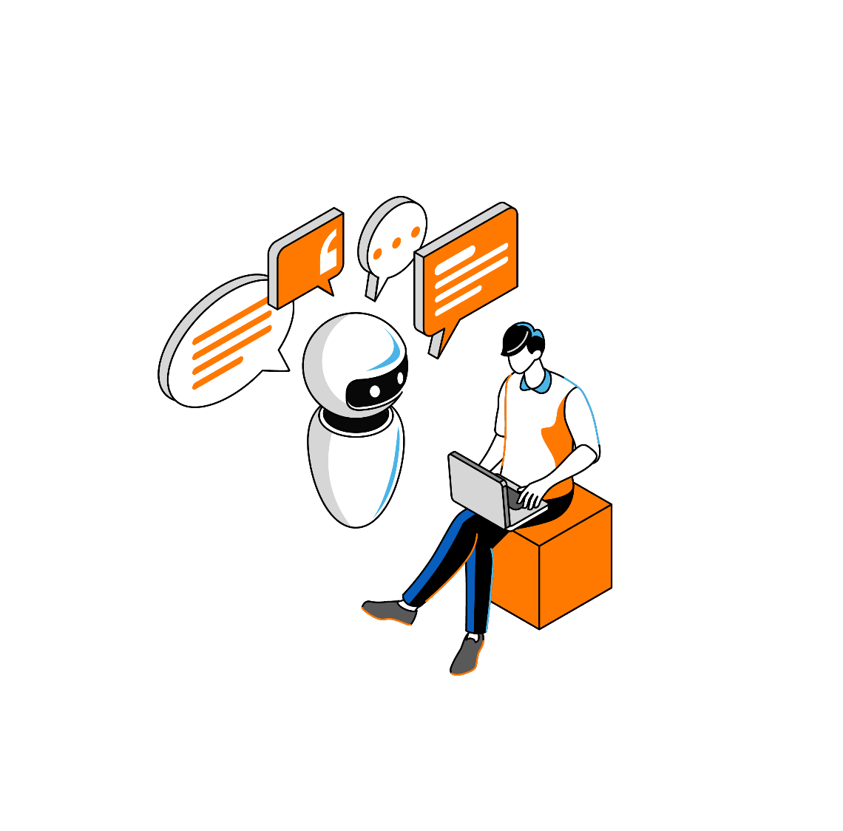
Better orchestration, better customer experiences
Customer experience
By connecting human and digital touchpoints across the entire customer journey, our customers can deliver consistent and personal experience, at every step.
Getting that orchestration right means meeting end-customers where they are, building satisfaction and loyalty that lasts. And with Generative AI helping to strike the right balance between human and automated interactions, it also means doing it more efficiently.

Slide 20
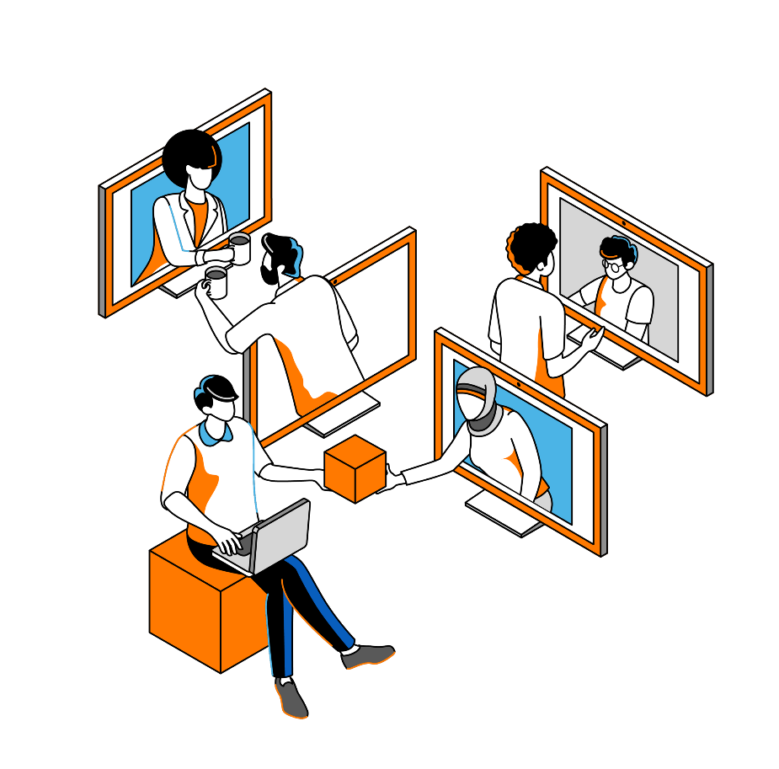
Building positive productivity at work with digital technology
Employee experience
In the workplace, tools are becoming increasingly digitalized, and generative AI is shaking up everyday life. Companies are faced with the challenge of offering their employees a digital work environment that meets their business challenges.
Our proposal: create the conditions for positive productivity to unleash individual and collective efficiency, without compromising on digital confidence and environmental impact.
The only European operator-integrator capable of designing and implementing efficient and responsible employee experience solutions.
Consulting - Telephony - Collaboration - Hybrid working - Next-gen offices - Quality of experience - Adoption - Security - Productivity - Technical support - Office workers - Workers without an office

Slide 21
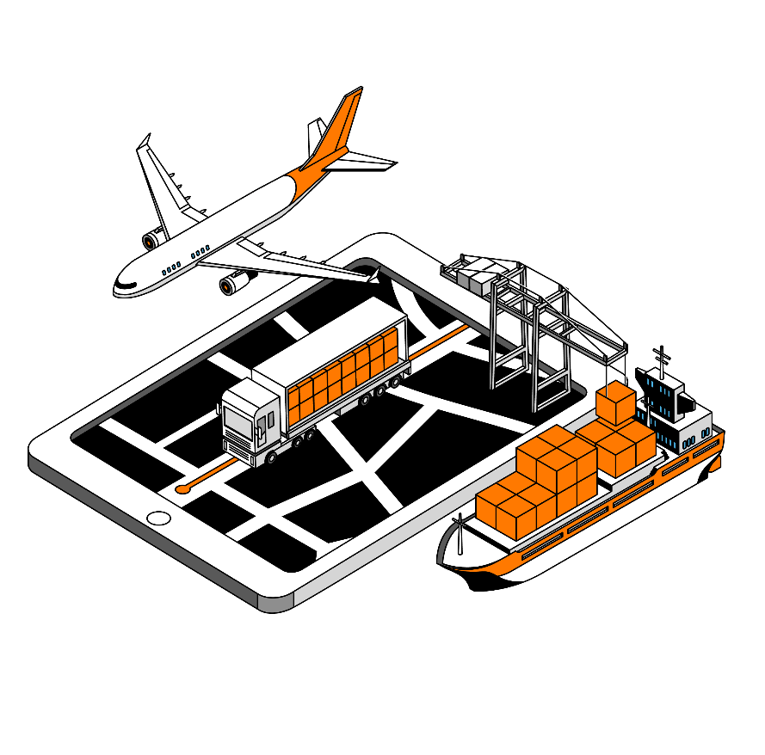
Driving operational excellence through digital and IoT
Operational experience
IT technologies and solutions applied to IoT improve productivity and security, optimize processes, reduce costs and enable our industrial customers to offer new services on their products.
Orange Business supports them at every step: identifying the right use cases, building and maintaining secure infrastructures, bridging IT and OT, and accelerating value creation.
Thousands of experts to design, implement and operate network and data infrastructure solutions adapted to IoT.
Our Customer Innovation Center to explore business use cases and our associated solutions.
Orange Innovation to innovate and work with our industrial customers on their future uses.

Slide 22

3. How we do it The right expertise, at every step

Slide 23



Our ability to deliver on our promises rests on three foundations
Our recognized expertise
Our people & culture
Our commitments
A unique combination of technical depth, analyst recognition and a world-class partner ecosystem acknowledged across networks, cloud, cybersecurity, data & AI.
30,000 employees, experts in B2B, united around 3 shared values and committed every day.
Acting for the planet, promoting responsible digital technology and valuing our differences, because sustainable transformation starts from within.

Slide 24


Our expertise is recognized by analysts and partners at every stage of the digital value chain
Partner Status at a glance
AWS
Advanced Partner
Managed Service Provider (MSP)
Microsoft
Gold (MAICPP)
Partner of the year
In 2025, Orange Business was mentioned in 158 analysts' publications.
Cisco
Global Gold Partner
NiCE
Platinum
DELL
Titanium: France, Pologne
Platinum: India, Senegal
NVIDIA
Registered (Cloud Services and Solutions provider)
Leader in 56 reports, among which:
Fortinet
Regional Expert partner EMEA, AME, APAC
Palo Alto Networks
Diamond
#1 EMEA Partner
Genesys
Elite
Samsung
Elite
The 2026 Gartner® Magic Quadrant™ for 4G and 5G Private Mobile Network Services and leader for Global WAN Services
GlobalData.® leader in 2025 for Company Assessment - Global Enterprise
Google Cloud
Premier
ServiceNow
Elite
HPE
Platinum (Cloud & Network)
Zscaler
Premier, Global , Direct MS & Delivery EMEA
Huawei
Global Strategy Partner

Slide 25






Powered by 30,000 experts delivering excellence worldwide
10,000+
Digital Experts
10,000 Employees
Certified Services
dedicated to customer service around the world: responsible for the deployment and day-to-day solutions’ management
9001
14001 20000 27001
of which...
7,000+ AI, Data, Cloud Experts
3,100+ Cyber Experts
400+ IoT Experts
32
languages spoken

Slide 26

United by a culture based on 3 values to better adapt to market changes
These values shape the way we work with our stakeholders every day and the way we build our teams for tomorrow.
We act to offer the best to our customers, colleagues and stakeholders.
Caring
We keep our promises, act responsibly and speak the truth.
Responsible
We are ambitious and determined, taking the initiative to seize opportunities.
Bold

Slide 27


Building the skills of tomorrow Investing in our people to stay ahead of all the challenges.
Orange Learning portal: professional training courses open for all employees, focused on digital expertise: CSR, data & AI, cybersecurity, digital trust, Cloud and digital platforms, project management and agility at scale.
Digital Services School: a Qualiopi-certified training organization drawing on 200+ experts in Data, AI, Generative AI, Cloud, and Digital. It offers a wide catalog of off-the-shelf and customized courses, some of which are France Compétences certified.
In-house business schools: 4 specialized schools to support skills development for our employees.
Our 2030 ambitions
15,000 employees upskilled/reskilled
30,000 certifications with 50% targeted to drive our digital transformation in Data & AI, Cloud and Security

Slide 28



Our responsibility: for the planet, for people, for a better digital world
Acting for the planet
Committed to responsible digital technology
Valuing our differences
In 2020, we launched the Green Act program to embed environmental responsibility across the entire company and its stakeholders. Our ambition: net zero carbon by 2040, and a 45% reduction in our carbon footprint by 2030.
Our efforts are internationally recognized, with certifications from SBTi and EcoVadis. Orange ranks in the top 1% of eco-responsible companies, with a score of 88/100.
Over 95% of our employees have been trained in cybersecurity and business ethics at Group level.
At Orange Business, 70% of employees are confident that AI will have a positive impact on their field of activity in the coming years.
We take an ethical and inclusive approach to data and AI: Orange is a signatory of the 1st international charter for inclusive AI and a member of the Sustainable AI committee. It is also the first company to be awarded the GEEIS-AI label.
Through the "Women Up" program and local initiatives, Orange and Orange Business actively promote professional equality and feminization of technical professions, both in France and abroad. 86% of employees consider diversity one of Orange Business's key strengths. At Orange Business, women represent more than 32% of our employees with 37% holding positions in the top Management.
At Orange Business, we have a dedicated policy for the inclusion of employees with disabilities.

Slide 29
Orange Business is here

